Slide 1

Data assimilation
P. Lewis
https://link.springer.com/chapter/10.1007/978-81-322-2547-8_4

Slide 2
Data assimilation
What is DA?
What does DA do?
Methods
Sequential (KF, PF)
Variational
Example
MacBean et al. 2018 (Orchidee, SIF)

Slide 3
What is Data Assimilation?
A set of techniques to combine data with some underlying process model to provide optimal estimates of the true state and/or parameters of that model.

Slide 4
What is Data Assimilation?
It is not just model inversion.
But could be seen as a process constraint on inversion (e.g. a temporal constraint)
https://climatedataguide.ucar.edu/climate-data/simplistic-overview-reanalysis-data-assimilation-methods

Slide 5
Data Assimilation is Bayesian
Bayes’ theorem:
P(A|B) | = | P(B|A) P(A)
 |  | P(B)
Intro to DA with EO : Lahoz & Schneider (2014)

Slide 6
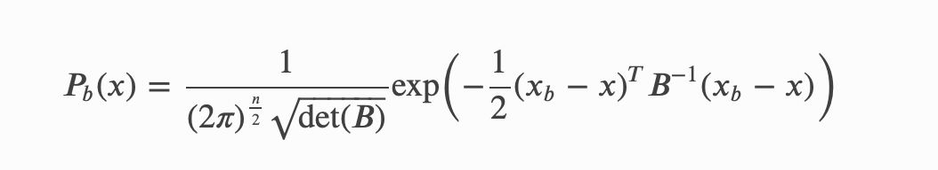
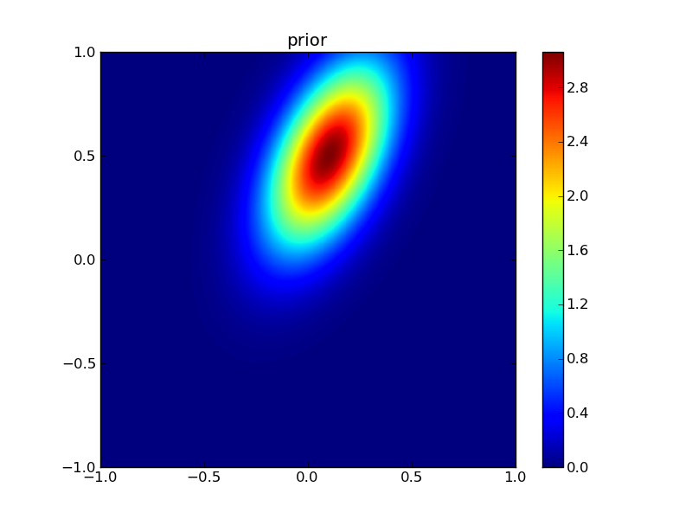
prior

Slide 7
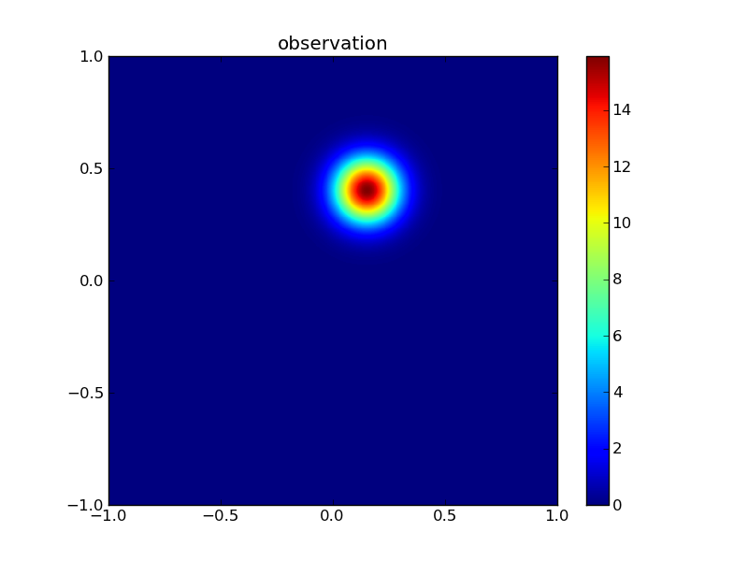
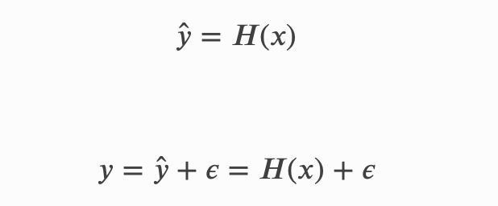

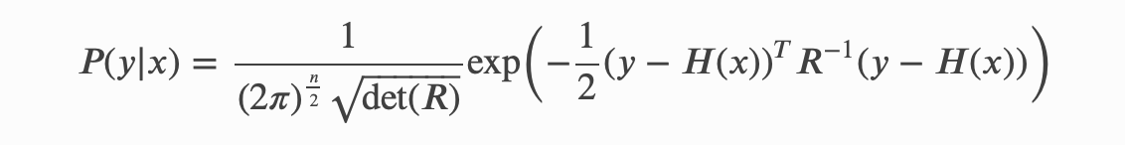
observation

Slide 8
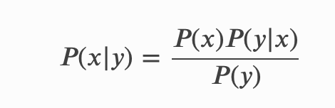
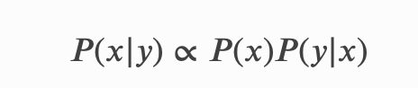
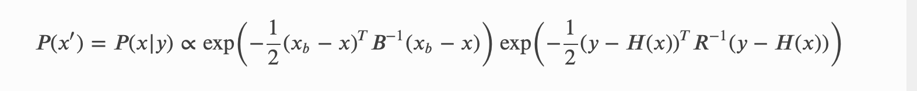
update

Slide 9


Slide 10
What does DA aim to do?
Use all available information about
A Priori information
The underlying model
The observations
The observation operator
Including estimates of uncertainty and the current state of the system
To provide a best estimate of the true state of the system with quantified uncertainty

Slide 11
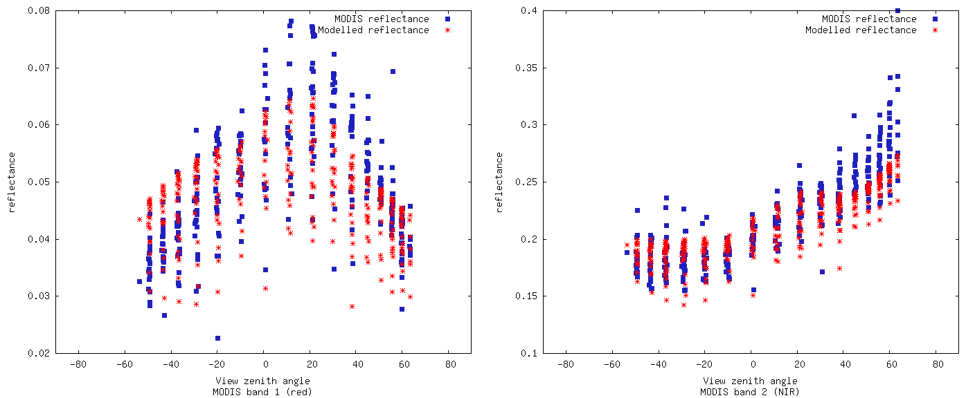
Modelled vs. observed reflectance
Red
NIR
Note BRF shape in red: can’t simulate with 1-D canopy (GORT here)

Slide 12
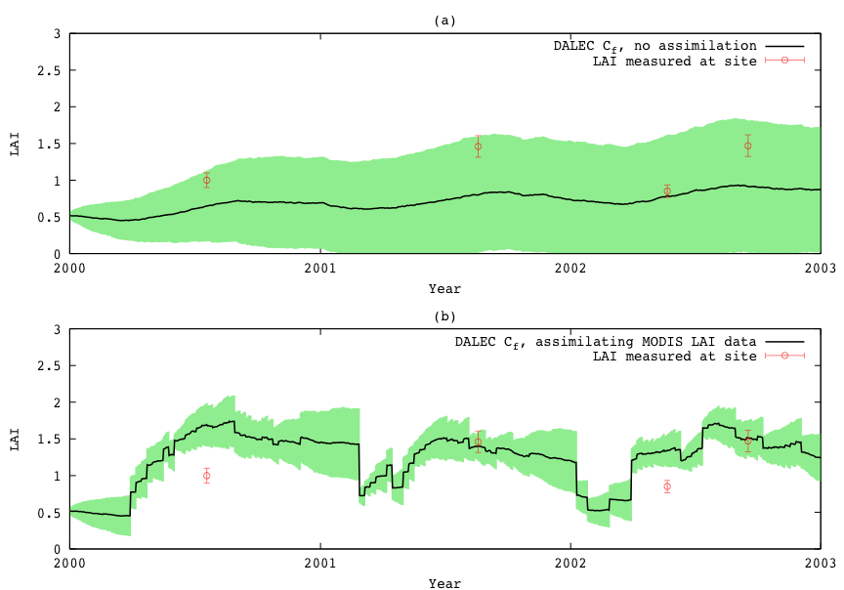
Kalman Filter DA
Data assimilation into DALEC ecological model: Quaife et al. 2008

Slide 13
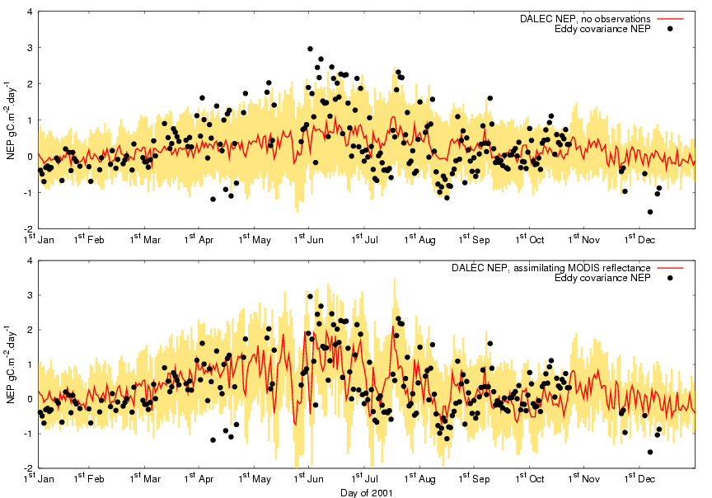
NEP results
No assimilation
Assimilating MODIS
(red/NIR)
DALEC model calibrated from flux measurements at tower site 1

Slide 14

Mean NEP for 2000-2002
EO data: spatial DA
Flux Tower
4.5 km
Spatial average = 50.9
Std. dev. = 9.7
(gC/m²/year)
15
65
gC/m²/year

Slide 15
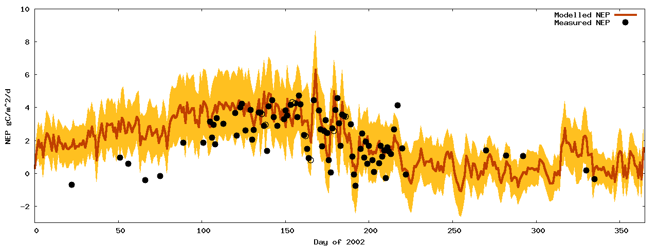
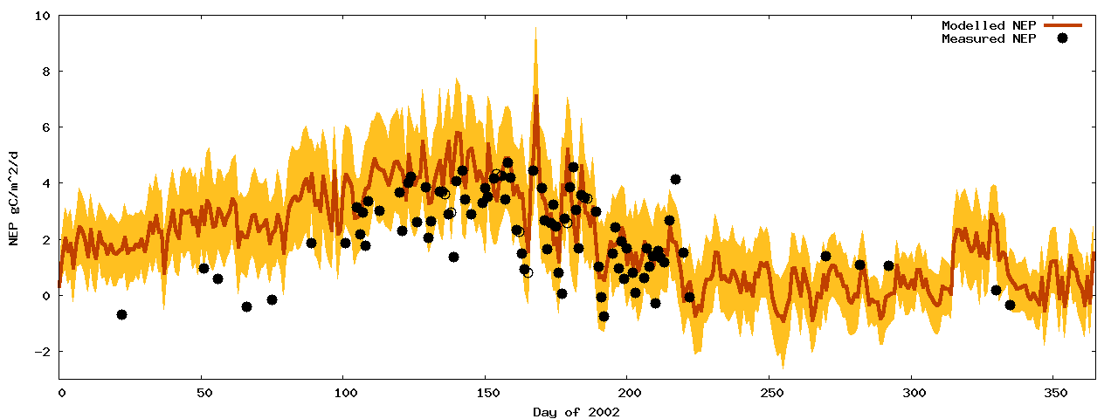
NEP – Site2 (intermediate) parameters, with/without DA
Model running at Site 2, Oregon
Site 1 model EO-calibrated at site 2 NEP observations from Site 2
Shows ability to spatialise

Slide 16
Nominal classification of DA
Sequential
Smoothers
Variational

Slide 17
Sequential methods
Kalman Filter
Variants - EKF
Ensemble Kalman Filter
Variants – Unscented EnKF
Particle filters
Lots of different types
true MCMC technique

Slide 18
The Kalman filter
Propagation step:
x = Mx⁻
P = MP⁻M^{T} + Q
Analysis step:
x* = x + K( y – Hx )
K = PH^{T}( HPH^{T}+R )⁻¹
Model
Covariancematrix
Stochastic forcing
Kalman gain
Observation covariance matrix
Observation operator
State vector
Observation vector

Slide 19
The Kalman Filter
Linear process model
Linear observation operator
Assumes normally distributed errors

Slide 20
The Extended Kalman filter
Propagation step:
x = m(x⁻)
P = M'P⁻M'^{T} + Q
Analysis step:
x* = x + K( y – h(x) )
K = PH'^{T}( H'PH'^{T}+R )⁻¹
Jacobian matrix
Jacobian matrix

Slide 21
The Extended Kalman Filter
Linear process model
Linear observation operator
Assumes normally distributed errors
Problem with divergence

Slide 22
The Ensemble Kalman filter
Propagation step:
X = m(X⁻) + Q
no explicit error propagation
Analysis step:
X* = X + K( D – HX )
K = PH^{T}( HPH^{T}+R )⁻¹
State vector ensemble
Perturbed observations

Slide 23
The Ensemble Kalman Filter
P estimated from X
Non linear observations using augmentation:
Xª = h(X)
X

Slide 24
The Ensemble Kalman Filter
No assimilation
Assimilating MODIS surface reflectance bands 1 and 2

Slide 25
The Ensemble Kalman Filter
Avoids use of Jacobian matrices
Assumes normally distributed errors
Some degree of relaxation of this assumption
Augmentation assumes local linearisation

Slide 26
Particle Filters
Propagation step:
X = m(X⁻) + Q
Analysis step:
e.g. Metropolis-Hastings

Slide 27
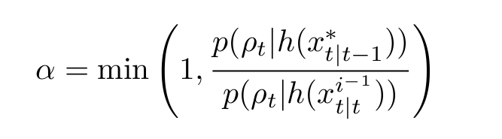
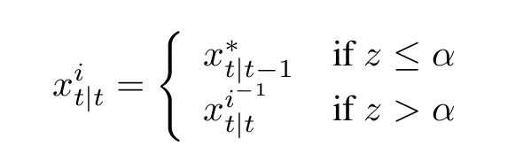
Particle Filters

Slide 28
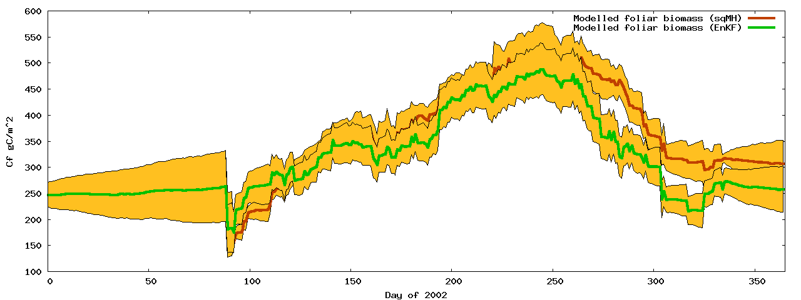
Particle Filters
No available observations

Slide 29
Particle Filters
Fully Bayesian
No underlying assumptions about distributions
Theoretically the most appealing choice of sequential technique, but…
Our analysis show little difference with EnKF
Potentially requires larger ensemble
But comparing 1:1 is faster than EnKF

Slide 30
Sequential techniques
General considerations:
Designed for real time systems
Only consider historical observations
Only assimilates observations in single time step
Can lead to artificial high frequency components

Slide 31
Smoothers
Extension of sequential techniques
All observations effect every time step
Analogous to weighting on observations
[ smoothing-convolution / regularisation ]
Difficult to apply in rapid change areas

Slide 32
Variational techniques
Expressed as a cost function
Uses numerical minimisation
Gradient descent requires differential
Traditionally used for initial conditions
But parameters may also be adjusted

Slide 33
3DVAR
Background
J(x) = ( x-x⁻ ) P⁻¹ ( x-x⁻ )^{T} +
( y-h(x) ) R⁻¹ ( y-h(x) )^{T}
Observations

Slide 34
3DVAR
No temporal propagation of state vector
OK for zero order approximations
Unable to deal with phenology

Slide 35
4DVAR
J(x) = ( x-x⁻ ) P⁻¹ ( x-x⁻ )^{T} +
( y-h(x_{i}) ) R⁻¹ ( y-h(x_{i}) )^{T}
Σ_{i}
Time varying state vector

Slide 36
Variational techniques
Parameters constant over time window
Non smooth transitions
Assumes normal error distribution
Size of time window?
For zero-order case 3DVAR = 4DVAR
4DVAR for use with phenology model
Absence of Q - propagation of P?

Slide 37
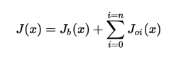
Variational data assimilation: strong constraint
Cost function minimisation
Multiple obs constraints
Plus prior
Strong constraint:
Prediction must be a valid model state
‘trust the model’

Slide 38
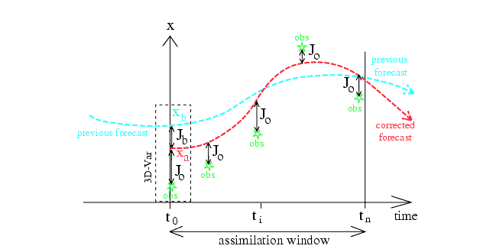
Variational data assimilation: strong constraint
Notes:
Figure from Bouttier and Courtier (1999) … should be self evident, but discuss with students. Mention 4D VAR … ie lots of these things happening over 3D space. Note that *normally* what is done is to adjust the initial conditions, eg in NWP. The ‘prior’ here is from a previous model run, or sometimes a climatology (average). Discuss advantages/disadvantages of strong constraint (trust the model … can correct for short term differences)

Slide 39
OCHIDEE with SIF
See applications of DA in notes
State-of-the-art: MacBean et al. 2018
Orchidee
French DGVM
Data for DA
GOME SIF

Slide 40
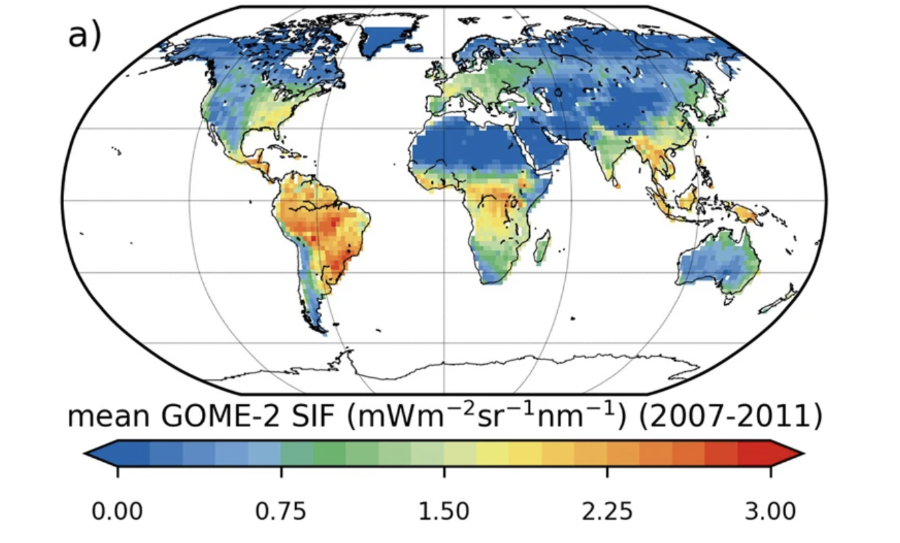
Solar-Induced Fluorescence
GPP = a + b SIF

Slide 41
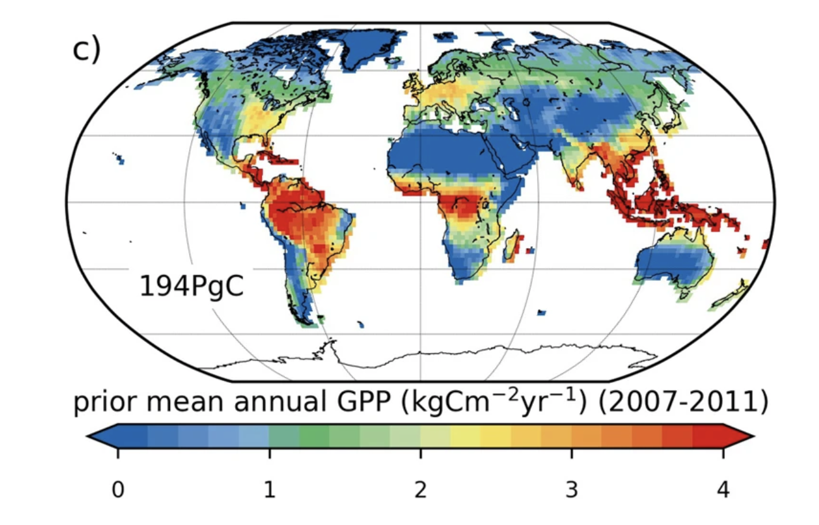
Model GPP (prior)
GPP = a + b SIF

Slide 42
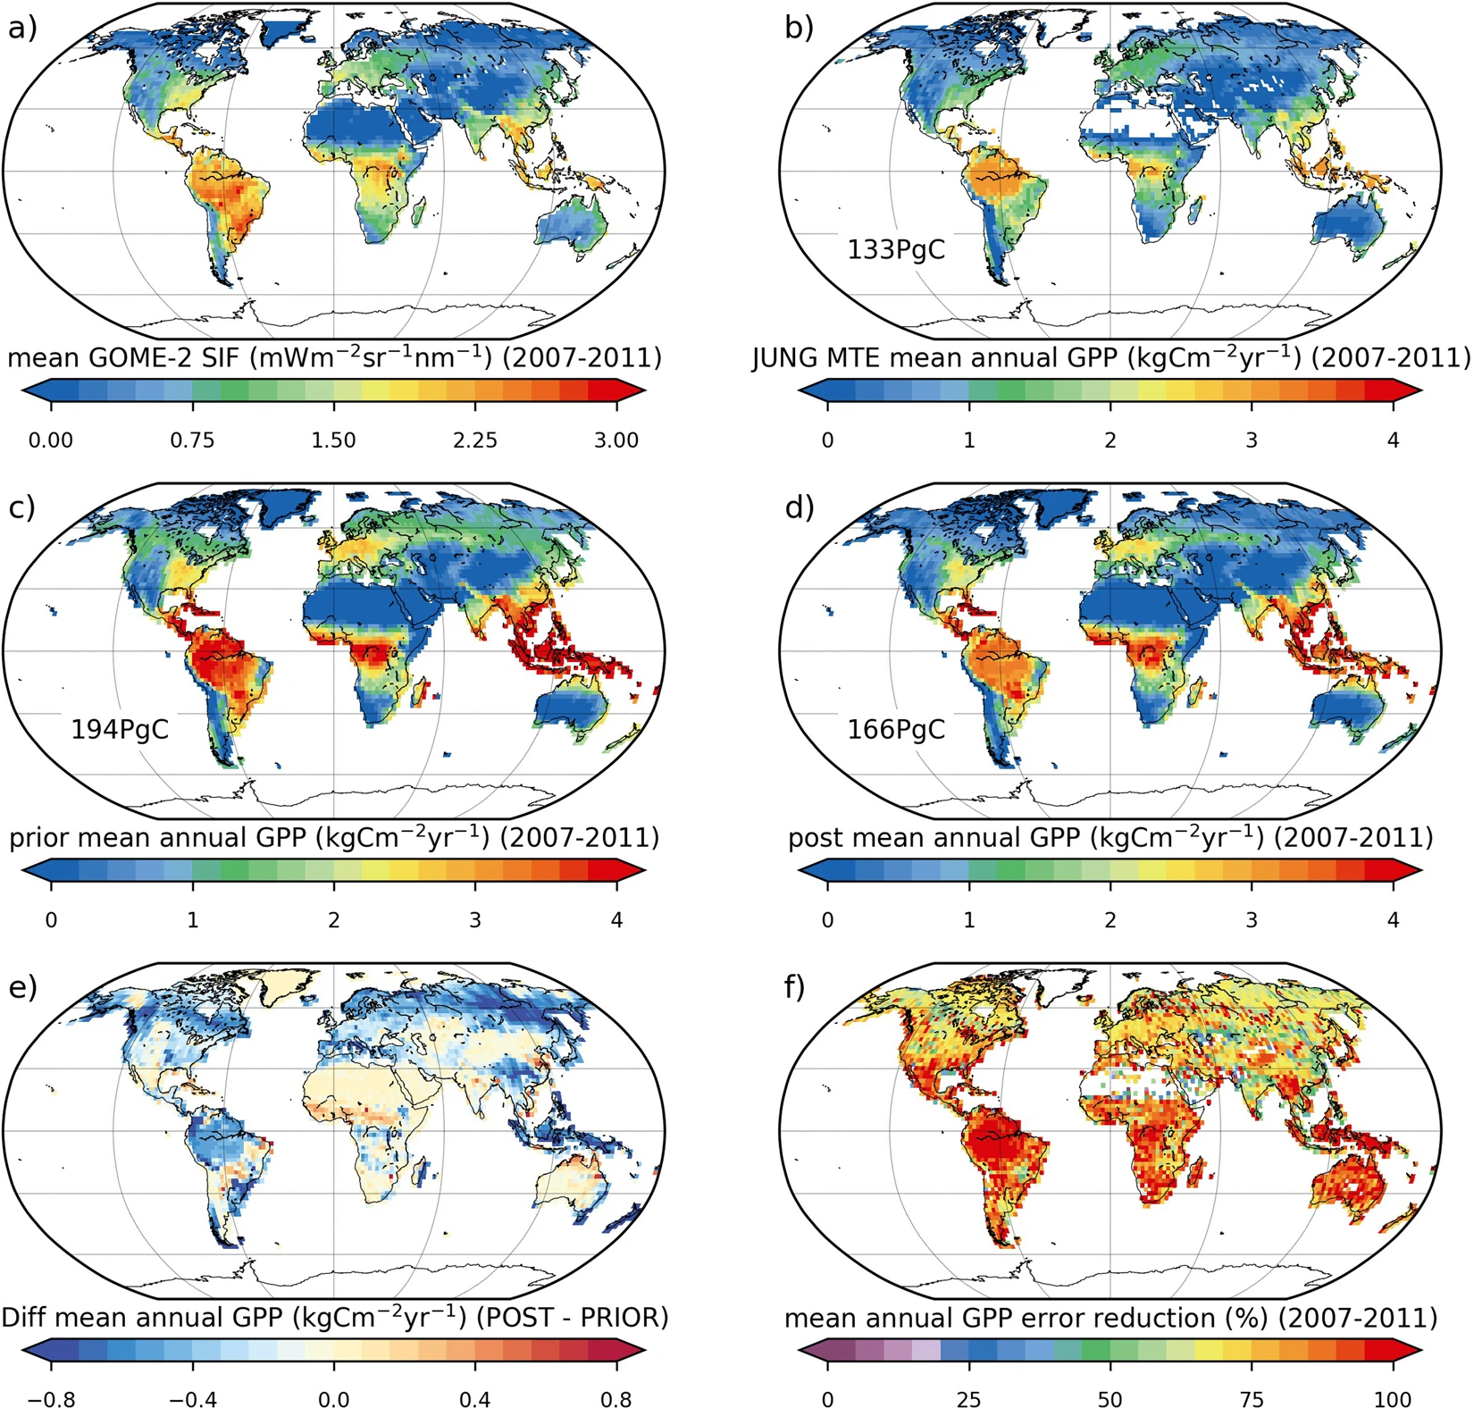
Notes:
83% reduction in GPP uncertainty

Slide 43
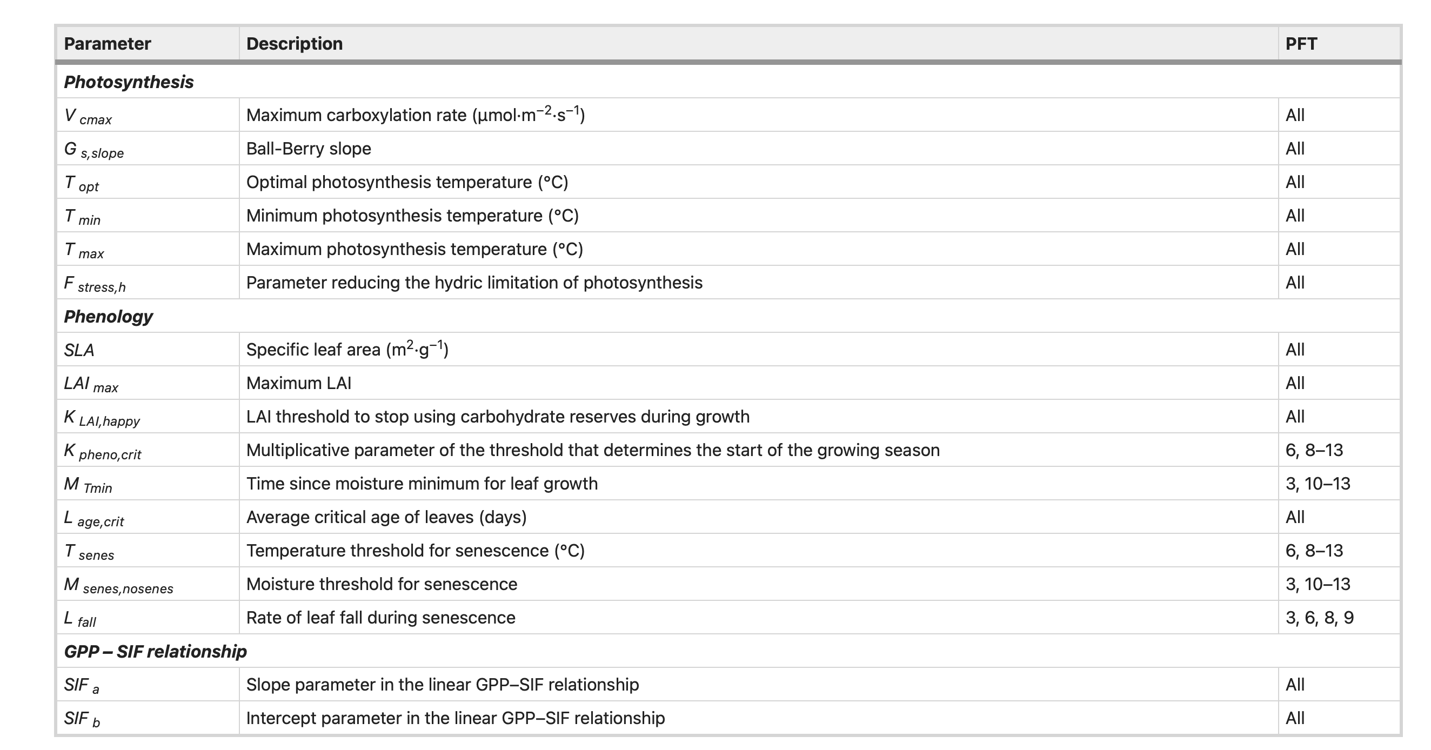

Slide 44
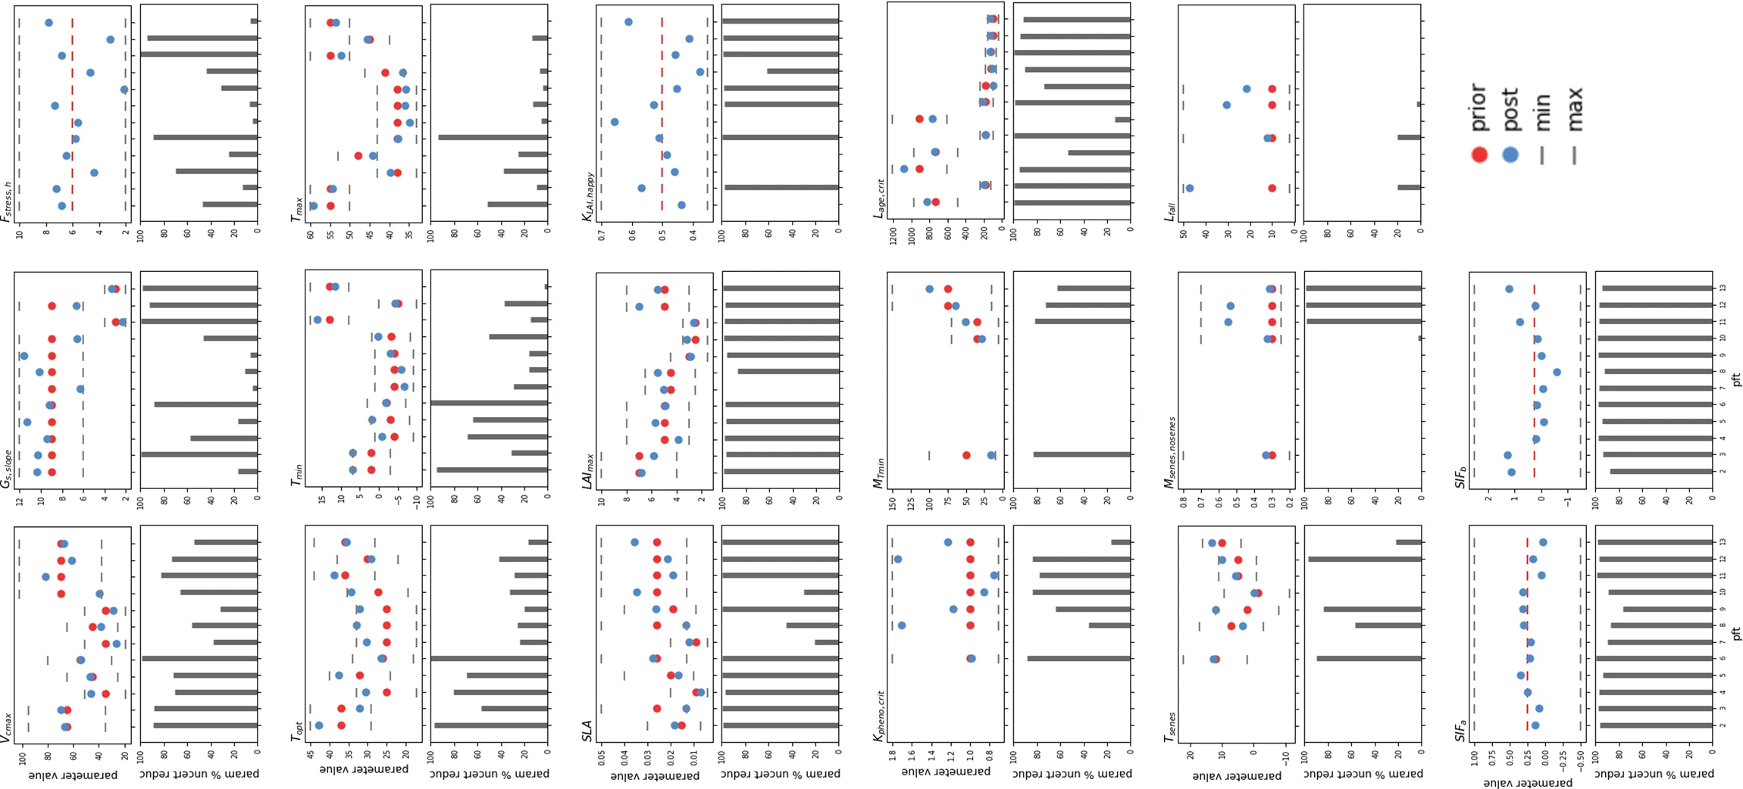
Model parameter

Slide 45
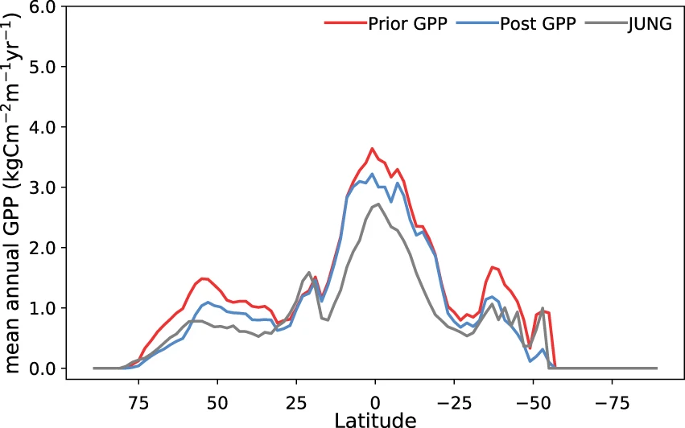
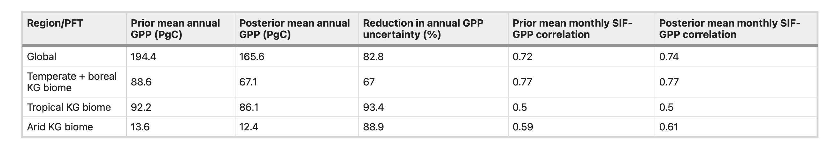

Slide 46
Data assimilation
What is DA?
What does DA do?
Methods
Sequential (KF, PF)
Variational
Example
MacBean et al. 2018 (Orchidee, SIF)

